Slide 1


A New People-Centric Approach to
Determining an Organization's Exposure to a Third-Party Data Breach
Workshop
January 2025
Notes:
12 seconds

Slide 2




Christine Dewhurst
Partner, NSC Tech
CISA, CPA,
B Mathematics,
University of Waterloo
Dr. Thomas Lee
CEO, VivoSecurity
BS Physics & EE
MS, PhD Biophysics University of Chicago

Slide 3



Workshops
Learn and Implement New Approaches
Risk Exercise:
Reducing Data Creep
Fast Pass:
What is My Probability of 3P Data Breach
Scenario:
Overcoming SOC2 Overload
NSC Tech & VivoSecurity
Notes:
12 seconds

Slide 4
Number of Vendors
Top 10 of 69 Vendors &
Their Employee Count
Biggest risk is number of vendors, think Principle of Least Privilege, there are 69 vendors with over 1M customer records. This is a major exposure!
Confirm this is correct and if so, action accordingly.
Vendor | Employees
Company 12 | 74,241
Company 16 | 60,043
Company 122 | 59,484
Company 25 | 44,096
Company 90 | 17,221
Company 30 | 14,284
Company 109 | 9,336
Company 3 | 10,665
Company 43 | 7,512
Company 94 | 6,057
Principle of Least Privilege (POLP)
Why is it so high?
Village or City or State?
NSC Tech & VivoSecurity

Slide 5
Risk Exercise: Reducing Data Creep
Objective: To identify & mitigate vendor data creep
Interactive Data Creep Identification (4 min) - How many clients does your company share data with? How do you know? What are the techniques? How do you track? Data connected to customers or people?
Group Shareback One (4 min) - Each group shares their approach to identify data creep.
Interactive Risk Mitigation Brainstorm (4 min) - Groups discuss and propose solutions to reduce data creep.
Group Shareback Two (4 min) - Each group shares one key insight or solution.
Wrap-Up (2 min) - Summarize best practices for identification and mitigation.
Key Takeaway…
🎯 Know Your N 🎯
“You cannot breach IT, if you do not share IT”
NSC Tech & VivoSecurity

Slide 6
Risk Exercise: Reducing Data Creep
Identifying Data Creep
1
2
3
Mitigating Data Creep
1
2
3
Key Takeaway…
🎯 Know Your N 🎯
“You cannot breach IT, if you do not share IT”
NSC Tech & VivoSecurity

Slide 7
Risk Exercise: Reducing Data Creep
Spicy Monday Topics
Data destruction – process, MSA, right to audit?
Why has not one company known how much data shared with?
Principle of Least Privilege
Principle of Least Privilege for large, medium and small records
IAM – creeping access
People turnover across and between companies
Local administrators
Lost laptops
Data Loss Prevention use cases
People centric - number of records vs customer view
Key Takeaway…
🎯 Know Your N 🎯
“You cannot breach IT, if you do not share IT”
NSC Tech & VivoSecurity

Slide 8
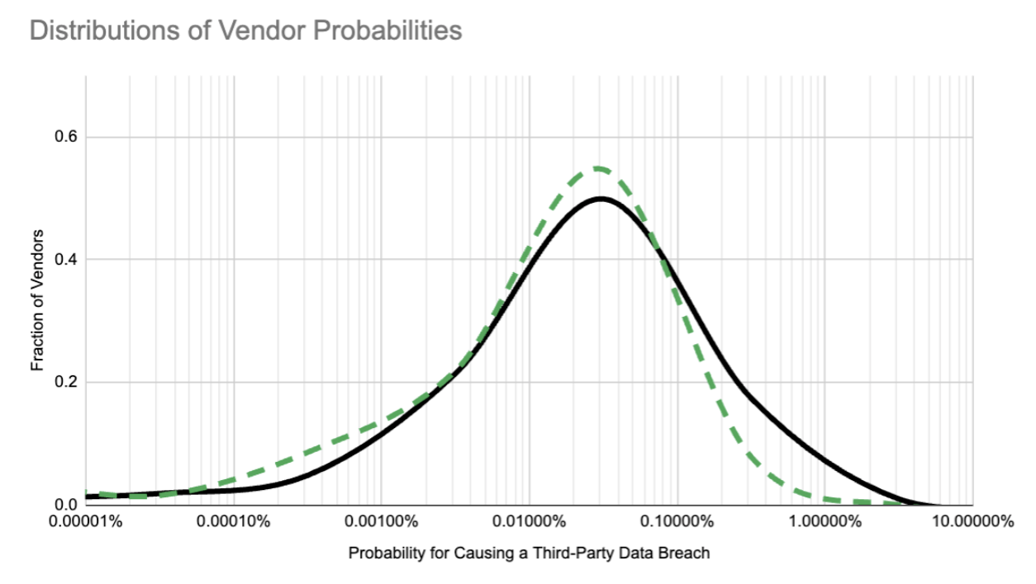
Probability of Data Breach
Probability of a Third-Party causing a large data breach is 3% or every 34 years across your 69 vendors.
As a public facing company this is significant exposure to your customers.
Empirical Regression Modeling
Average is 0.07
Cumulative Probability?
Customer Exposure View
NSC Tech & VivoSecurity

Slide 9
Fast Pass: What is My Probability of 3P Data Breach?
Objective: To practice quantitative methods for estimating the probability of a third-party data breach.
Interactive Vendor Probabilities (3 min) – Apply 0.07, break out into groups: 20, 100 and 500 vendors. Ok with the probability? What does it mean?
Group Shareback (4 min) - Probabilities, context and impact.
Customer view (2 min) - Define probability of third-party data breach risk and its impact. Simple calculation using pre-defined “0.07” from the customer view.
Interactive Customer Exercise (3 min) - How many companies do you share data with? How many companies share your data with other companies?
Group Shareback (2 min) - Probabilities and what that means.
Key Takeaway…
💡 Power of 0.07 x N
“You cannot manage IT, if you do not know IT”
NSC Tech & VivoSecurity

Slide 10
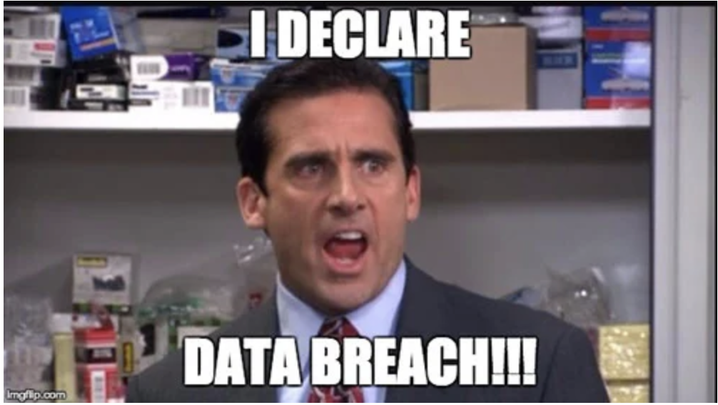
Why is my personal data breached so often!?
An Inconvenient (mathematical) Truth
Organizations must limit the number of vendors with access to their data
NSC Tech & VivoSecurity
Notes:
12 seconds

Slide 11
Customer Data View
If an average organization shares your data with 10 vendors
DB Cumulative Probability = 10 vendors x 0.07% or 0.7% or ~140 years
We share our data with 25 vendors.
Reality is we share with 250 vendors
DB Cumulative Probability
250 vendors x 0.07%
17.5% or ~6 years
NSC Tech & VivoSecurity
Notes:
15 seconds

Slide 12
Fast Pass: What is My Probability of 3P Data Breach?
Vendor Probabilities
Group 1
Group 2
Group 3
Customer Probabilities
Group 1
Group 2
Group 3
Key Takeaway…
💡 Power of 0.07 x N
“You cannot manage IT, if you do not know IT”
NSC Tech & VivoSecurity

Slide 13
Fast Pass: What is My Probability of 3P Data Breach?
Spicy Monday Topics
What is Probability really mean?
Simplicity of 0.07
Curve is the same for over 10,000+ companies
Customer view
Partnering with Vendors can grow my business
Cumulative probabilities with Tail-vendors > 0.17
Workshop Fungibility Challenge: Tail Vendor Blind Spots
Key Takeaway…
💡 Power of 0.07 x N
“You cannot manage IT, if you do not know IT”
NSC Tech & VivoSecurity

Slide 14
No CISA or CISSP
Sample of 10 vendors with no CISA or CISSP’s
Of your 150 vendors, there are 59 vendors with no CISSP’s, and 68 vendors with no CISA - appear to have no Cyber Security or Internal Audit function.
Is Company 123 comfortable with sharing data with these vendors without appropriately staffed 2nd and 3rd line functions.
Vendor | Employees
Company 1 | 4,765
Company 2 | 1,079
Company 6 | 674
Company 11 | 526
Company 13 | 522
Company 14 | 454
Company 15 | 451
Company 18 | 389
Company 20 | 369
Company 21 | 341
Cyber Security Function
Internal Audit Function
Village or City or State?
NSC Tech & VivoSecurity

Slide 15
Scenario: Overcoming SOC2 Overload
Objective: To help teams navigate the challenges of limited resources for vendor risk management activities.
Introduction (2 min) - CISA and CISSP levels are predictors of a data breach. Can we leverage this to identify higher risk and prioritize our precious resources.
Scenario Review (3 min) - CISO team supporting TPRM and you have one week to complete TPRA’s/SOC2 reviews.
Prioritization Exercise (7 min) - Each group selects criteria for prioritizing SOC2 reviews and applies them to the backlog.
Discussion (5 min) - Groups share their prioritization logic and challenges faced.
Key Takeaway is
👩‍💻 1K Emp ≠ 2.2 CISA + 3.5 CISSP
“Why are we sharing data with companies without Audit and Cyber teams?”
NSC Tech & VivoSecurity

Slide 16
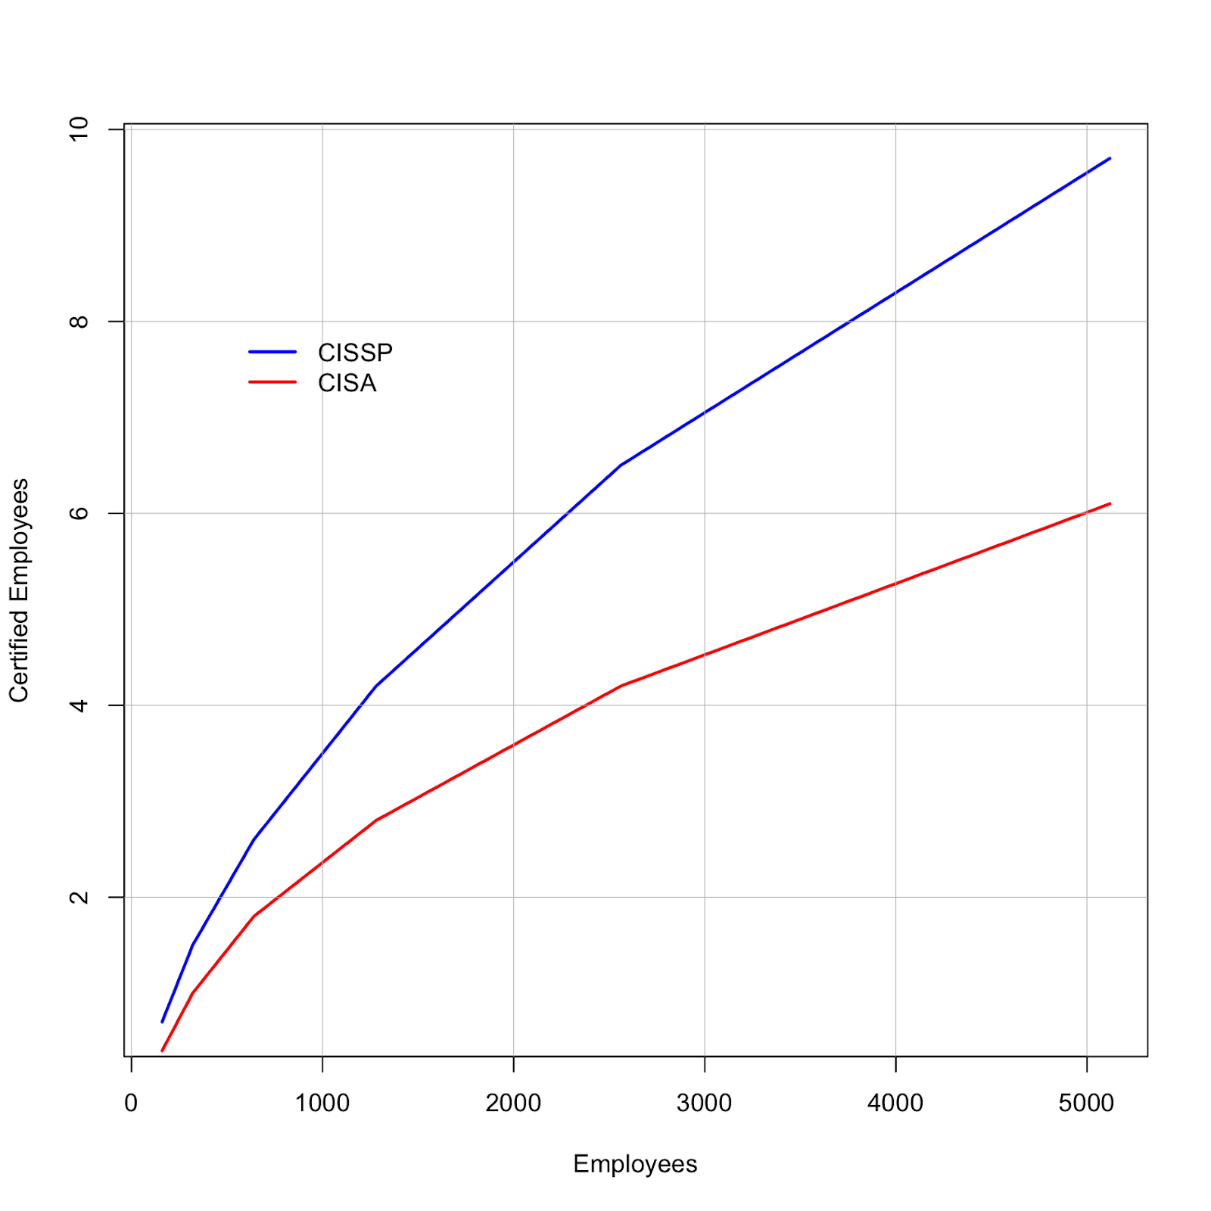
Scenario: Overcoming SOC2 Overload
13 Business’ | Emp. | CISSP | CISA
Financial technology services | 1,646 | 1 | 1
Financial service technologies | 770 | 1 | 0
RSA Technology | 4,554 | 114 | 16
Federal Reserve Bank of SF | 2,928 | 32 | 31
Financial crime detection | 3,067 | 2 | 0
Platform technologies | 674 | 0 | 0
Payment management solutions | 71 | 0 | 0
Law firm | 41 | 0 | 0
Auto buying service | 369 | 0 | 0
Mortgage closure technology | 723 | 3 | 1
Collection service | 526 | 0 | 0
Mortgage services platform | 522 | 0 | 0
Financial statement services | 196 | 0 | 0
Average CISA & CISSP as a function of full-time employees
NSC Tech & VivoSecurity

Slide 17
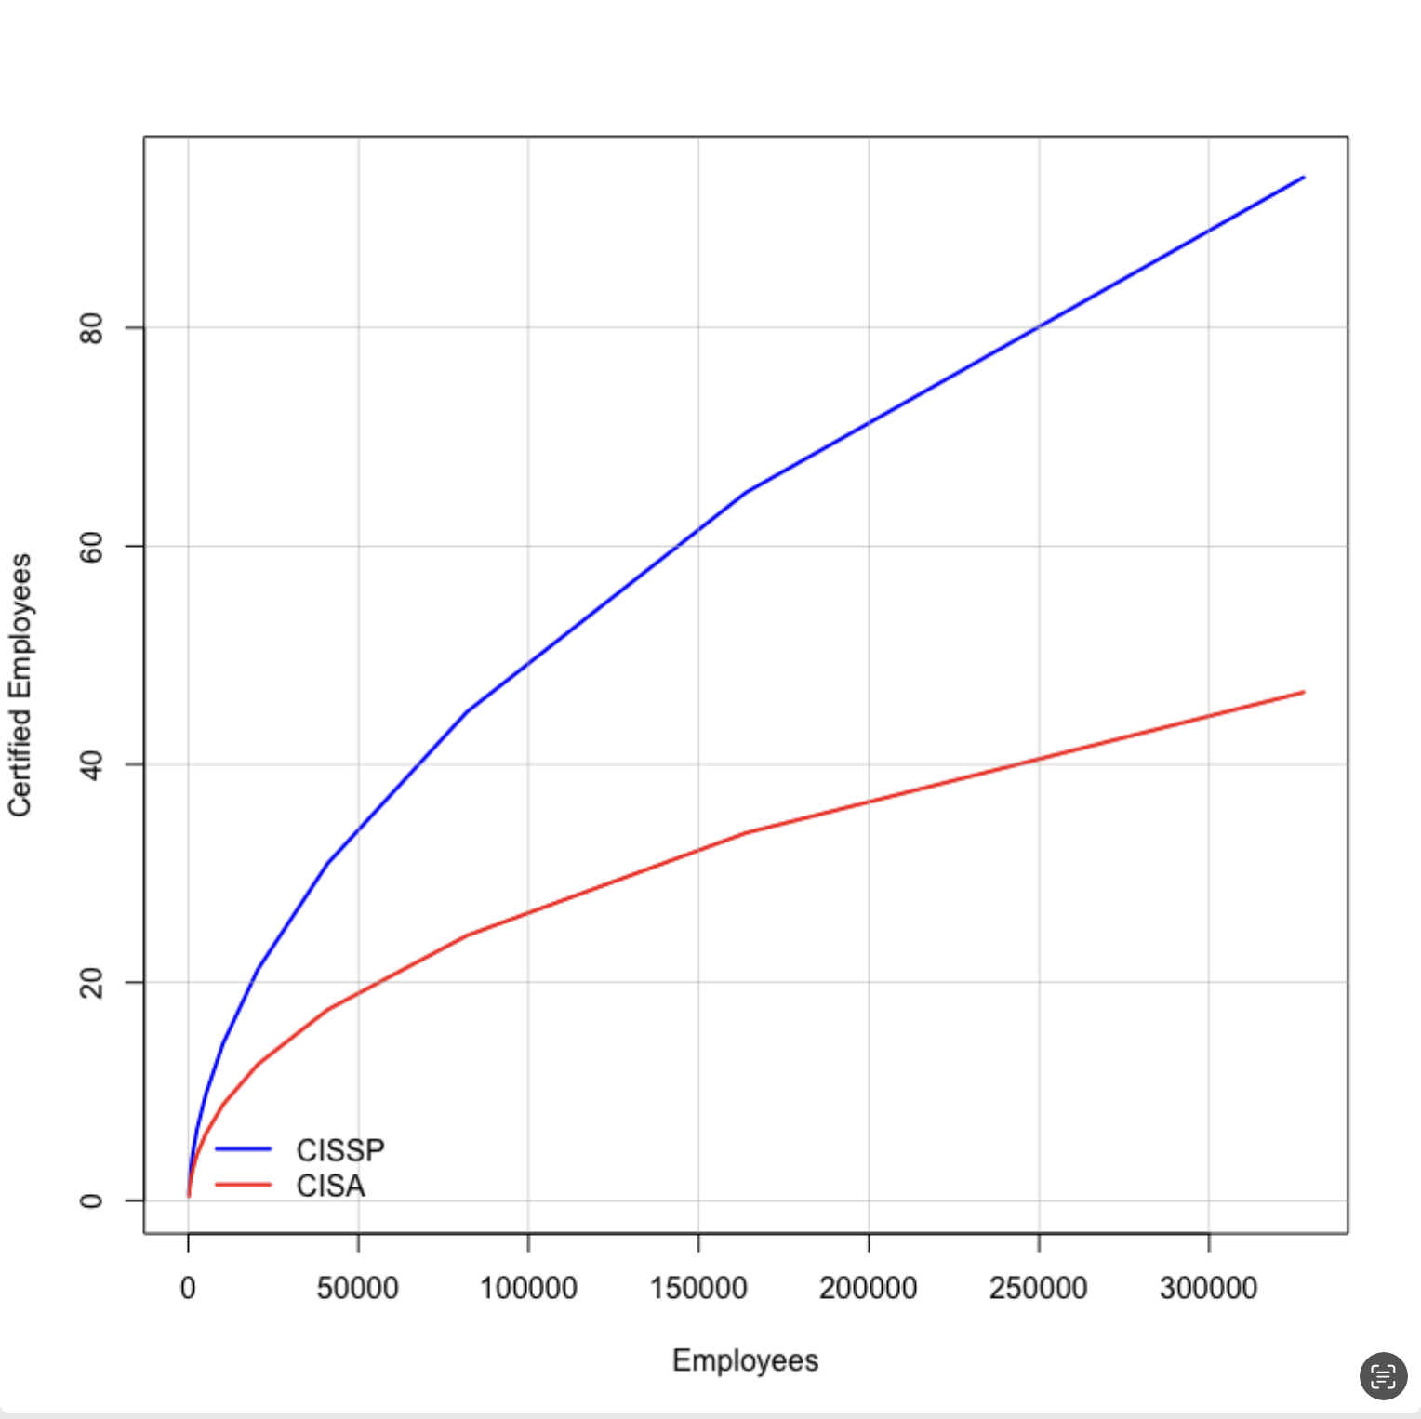
Scenario: Overcoming SOC2 Overload
Average CISA & CISSP as a function of full-time employees
8 Business’ | Emp. | CISSP | CISA
Financial services tech. | 51,591 | 159 | 78
Insurance | 57,022 | 23 | 48
Car rental | 86,885 | 20 | 10
Cloud-based human capital | 10,665 | 7 | 12
Financial technology | 10,712 | 30 | 16
Equifax | 20,720 | 85 | 39
Insurance | 60,043 | 25 | 36
Auto insurance | 44,096 | 52 | 28
NSC Tech & VivoSecurity

Slide 18
Scenario: Overcoming SOC2 Overload
Prioritization Approach 1
Group 1
Group 2
Group 3
Prioritization Approach 2
Group 1
Group 2
Group 3
Key Takeaway is
👩‍💻 1K Emp ≠ 2.2 CISA + 3.5 CISSP
“Why are we sharing data with companies without Audit and Cyber teams?”
NSC Tech & VivoSecurity

Slide 19
Scenario: Overcoming SOC2 Overload
Spicy Monday Topics
Why are we sharing data when no CISA & CISSP?
Why are we sharing data when not enough CISA & CISSP?
Need to add people-centric CISA/CISSP counts to vendor questionnaire – people matter!!!
SOC2 still the gold standard? People make the difference! People design and implement the controls!
Small vs large companies….is there a difference?
Outsourced security?
Is the TPRA list accurate ☺
Key Takeaway is
👩‍💻 1K Emp ≠ 2.2 CISA + 3.5 CISSP
“Why are we sharing data with companies without Audit and Cyber teams?”
NSC Tech & VivoSecurity

Slide 20

A New People-Centric Approach to Determining an Organization's Exposure to a Third-Party Data Breach
🎯 Know Your N 🎯
“You cannot breach IT, if you do not share IT”
💡 Power of 0.07 x N
“You cannot manage IT, if you do not know IT”
👩‍💻 1K Emp ≠ 2.2 CISA + 3.5 CISSP
“Why are we sharing data with companies without Audit and Cyber teams?”
NSC Tech & VivoSecurity

Slide 21

Thank you!!
Christine Dewhurst
Partner, NSC Tech
Christine.Dewhurst@nsctech.com
Dr Thomas Lee
CEO, VivoSecurity
ThomasL@vivosecurity.com

Slide 22
Shift Up Framework
Empirical Modeling in Action
Leveraging “People-Centric Principles” to identity and action your risk of a Third-Party data breach
NSC Tech & VivoSecurity
Planning
(Collecting)
Fieldwork
(Generating)
Fieldwork
(Analysis)
Report
(Determine)
Follow-up
(Action)
Vendor Details
Process
Results
Risk Appetite
Manage
Company provides vendor names, process criticality, amount & type of data shared
Contract details: data destruction, right to audit/ SOC 2, outsourced security
Modeler collects people certifications details & models’ results
Probability and impact of data breach is known
Strength of controls reviewed
Zero CISA / CISSP
Identify tail-vendors
Cumulative probability of data breaches
Provide normal distributions
Completeness of data shared, type of data and vendor contract
Are you willing to share data with no Cyber Security team?
How often are you willing to have data breach.
Ownership of risk appetite statement
Develop, implement and manage new and existing processes to meet risk appetite

